Slide 1

Environmental Test Document
# 1064
UCASAL

Slide 2
Overview
Performed tests:
Drop test
Thermal test
Vibration test
Vacuum test

Slide 3
Drop Test Configuration
Drop test Requirements:
This test requires a 61 cm non-stretching cord.
CANSAT, and free space so the cansat does not hit the ground.
The structure must not flex during the drop test.

Slide 4
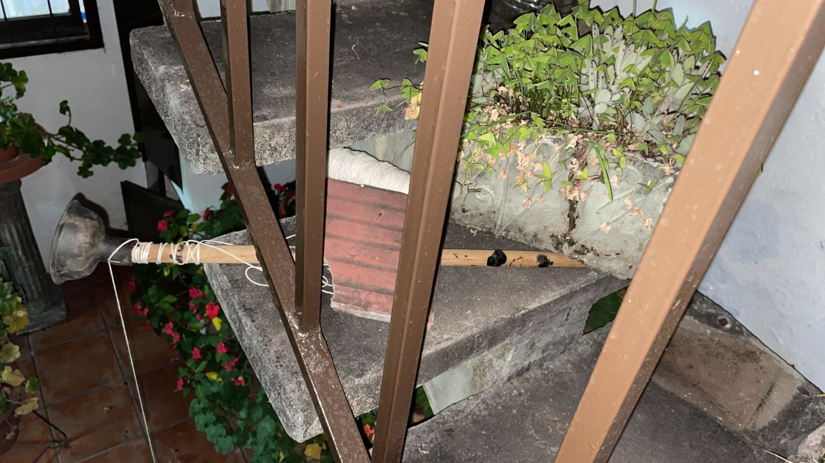
Drop Test Configuration
We put a thick wooden stick in a ladder secured by a weight to avoid movement, then we attached with the rope the cansat tied to the parachute cord with a length of 61 cm
Materials used:
Wooden stick and rigid rope

Slide 5
Drop Test Procedures
Drop Test Procedure
Power on CanSat.
Verify telemetry is being received.
Raise CanSat by the attached cord, so that the attachment points of the cord, on the eye bolt and the parachute, are at the same height.
Release the CanSat.
Verify the CanSat did not lose power.
Inspect for any damage, or detached parts.
Verify telemetry is still being received.

Slide 6
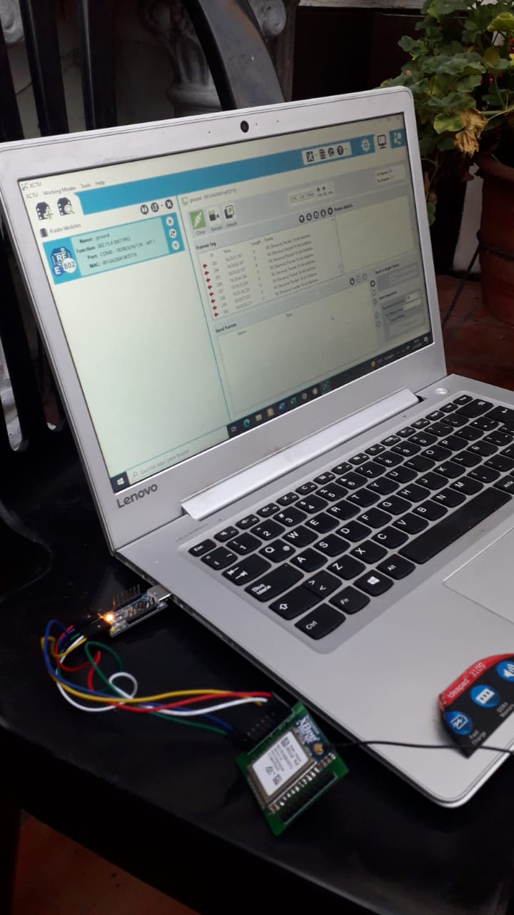
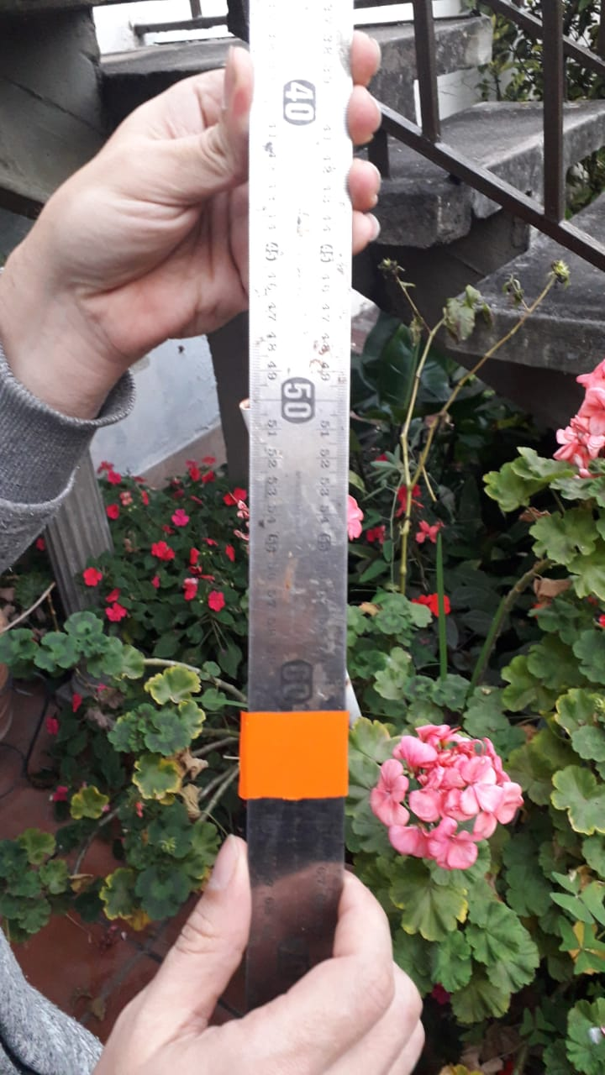
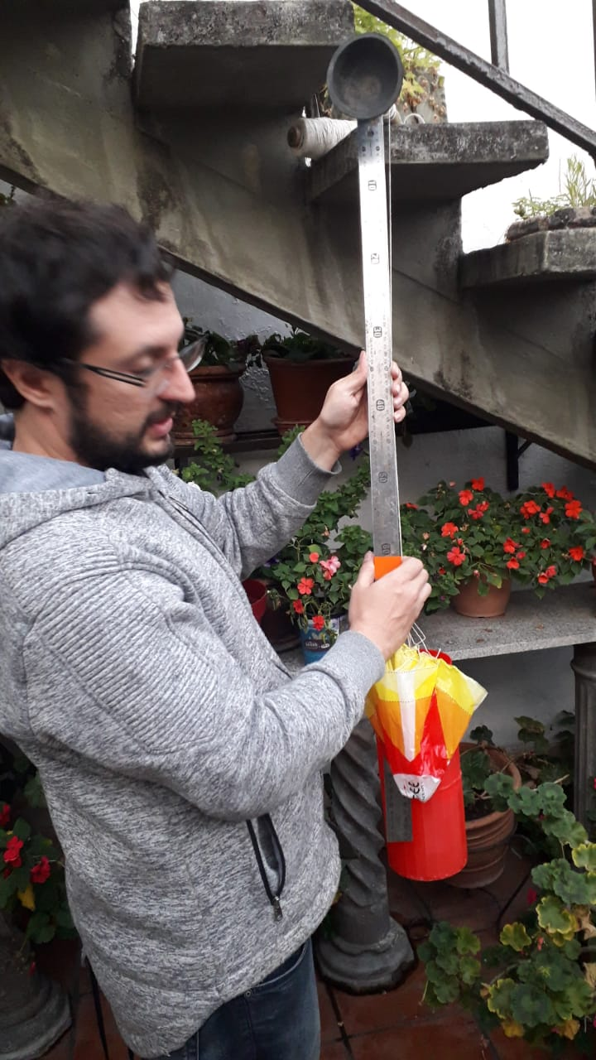
Drop Test Results
Pictures before the test

Slide 7
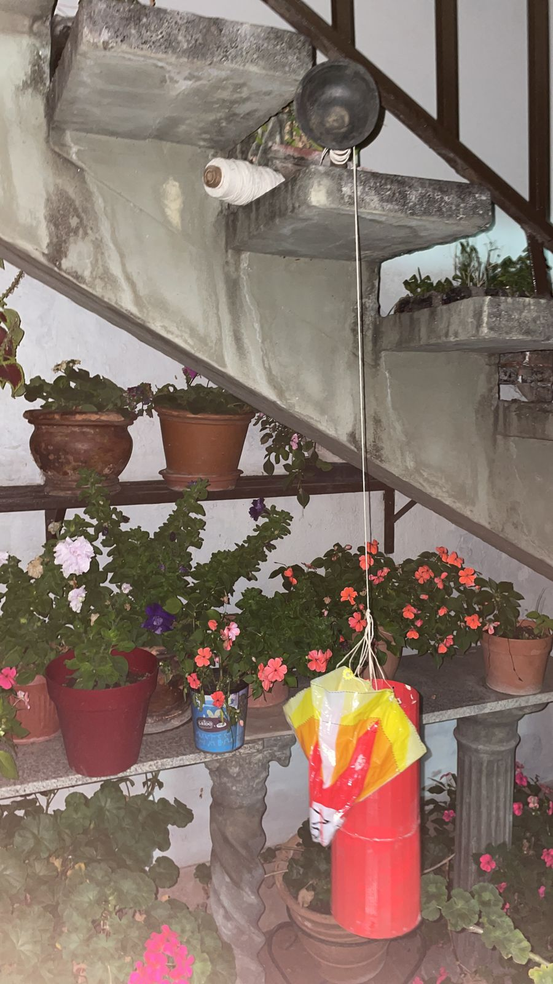
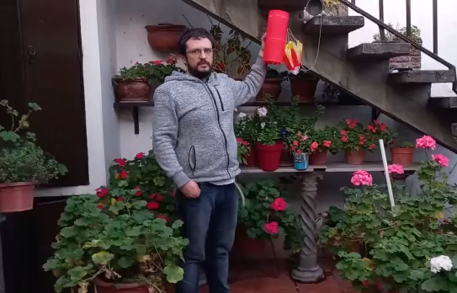
Drop Test Results
How CanSat was secured during the test

Slide 8
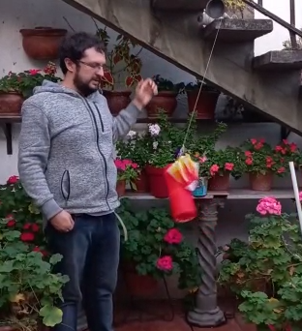
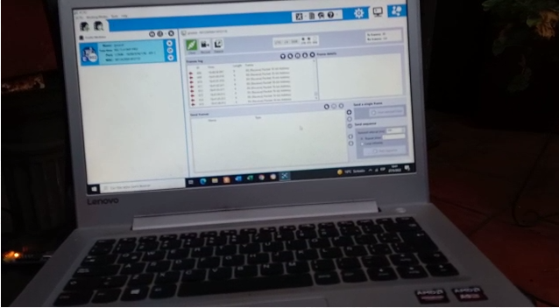
Drop Test Results
After the drop test we conclude that our cansat pass it successfully.

Slide 9
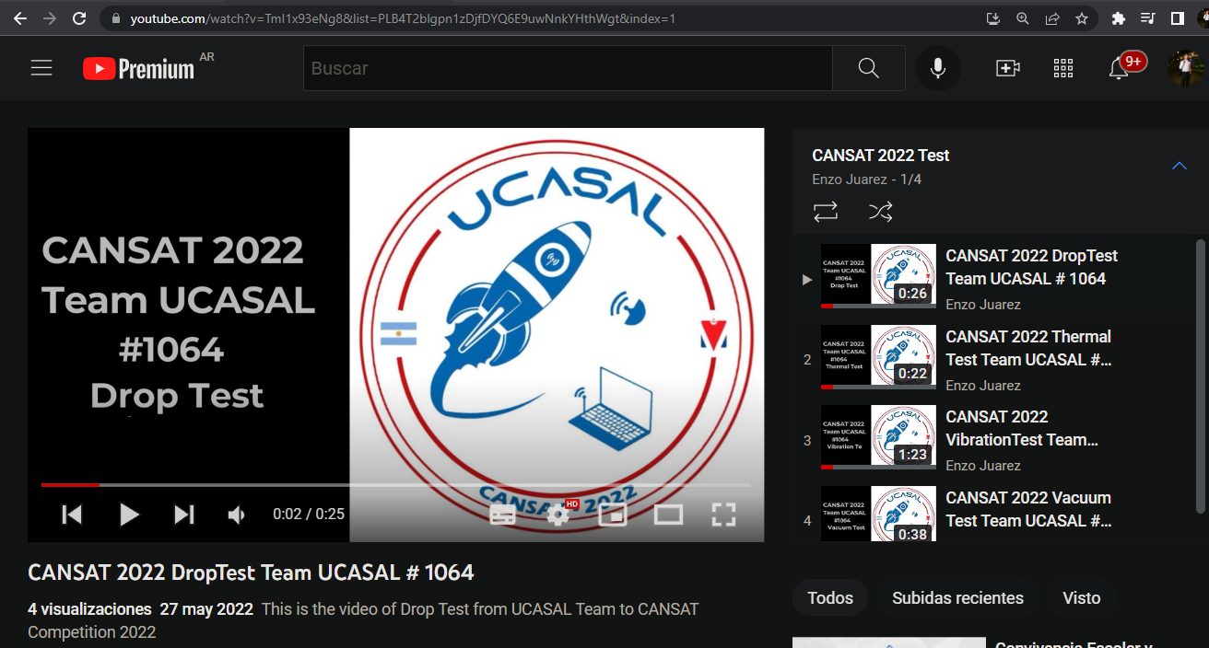
Drop Test Results
Drop test video link:
https://www.youtube.com/watch?v=TmI1x93eNg8&list=PLB4T2blgpn1zDjfDYQ6E9uwNnkYHthWgt&index=1

Slide 10
Thermal Test Configuration
Thermal test requirements:
This test requires a method to heat the CanSat to 60C for a period of 2 hours.
With the heated gun we could achieve a constant temperature because it has temperature regulation

Slide 11
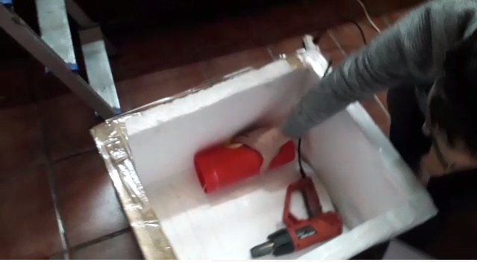
Thermal Test Configuration
Thermal test setup: A insulated foam box was builded with ductape and foam sheet cut to size, then a heat gun with temperature regulation.
Materials used:
Insulated foam box
Heat gun
Digital thermometer

Slide 12
Thermal Test Procedures
Thermal Test Procedure
Place CanSat into a thermal chamber.
Turn on the CanSat.
Close and seal the thermal chamber.
Turn on the heat source.
Monitor the temperature and turn off the heat source when the internal temperature reaches 60C and turn on the heat source when the temperature drops to 55C.

Slide 13
Thermal Test Procedures
6. Maintain the test conditions for two hours.
7. Turn off the heat source and perform visual inspection and any functional tests to verify the CanSat survived the thermal exposure and can operate as expected.
8. With the CanSat still hot, test any mechanisms and structures to make sure the integrity has not been compromised. Take precautions to avoid injury.
9. Verify epoxy joints and composite materials still maintain their strengths.

Slide 14
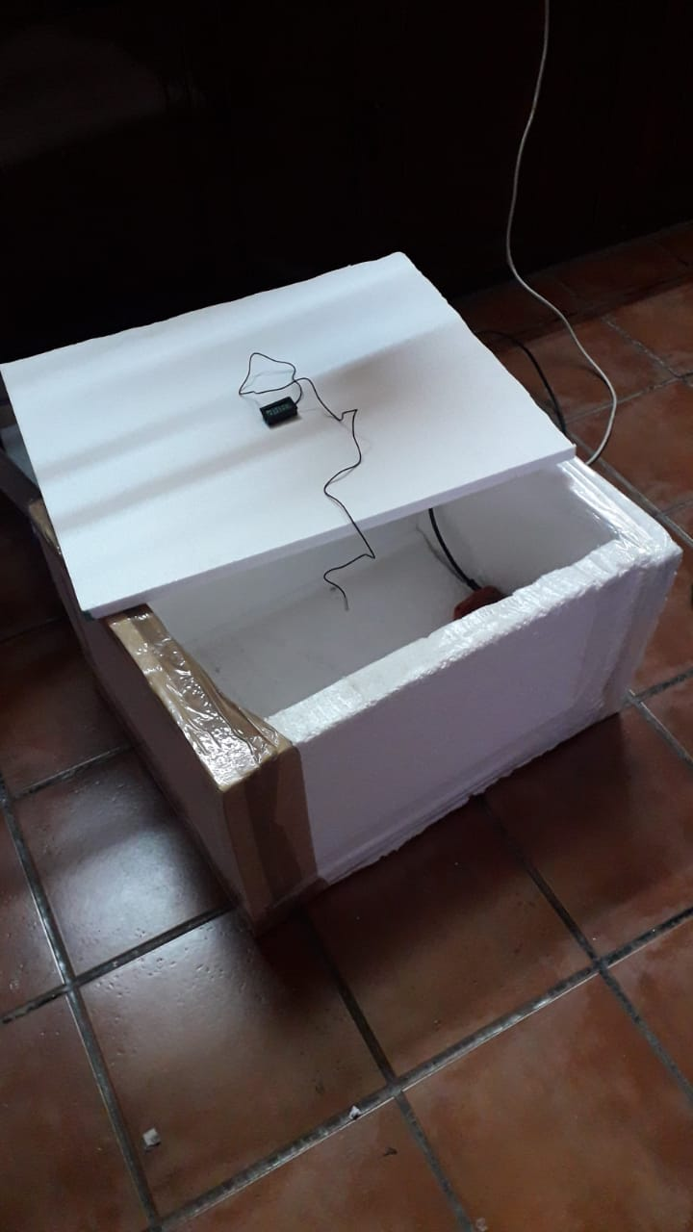
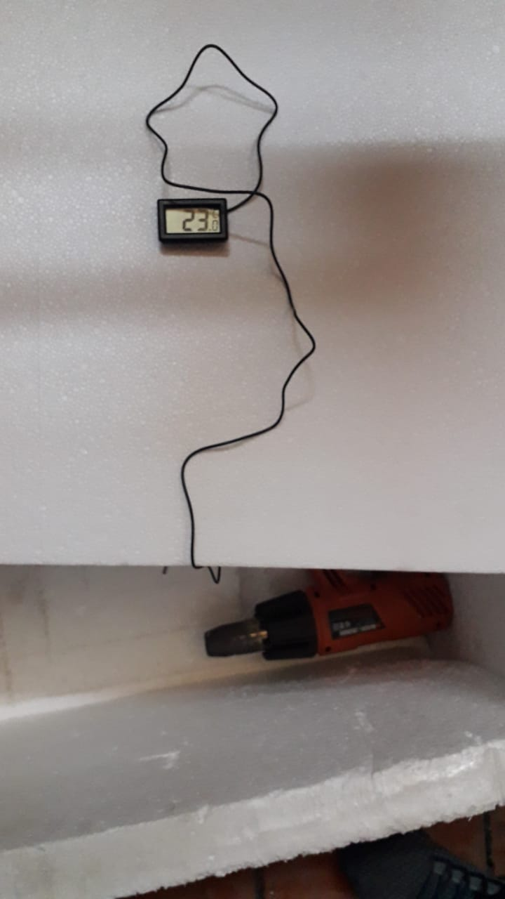
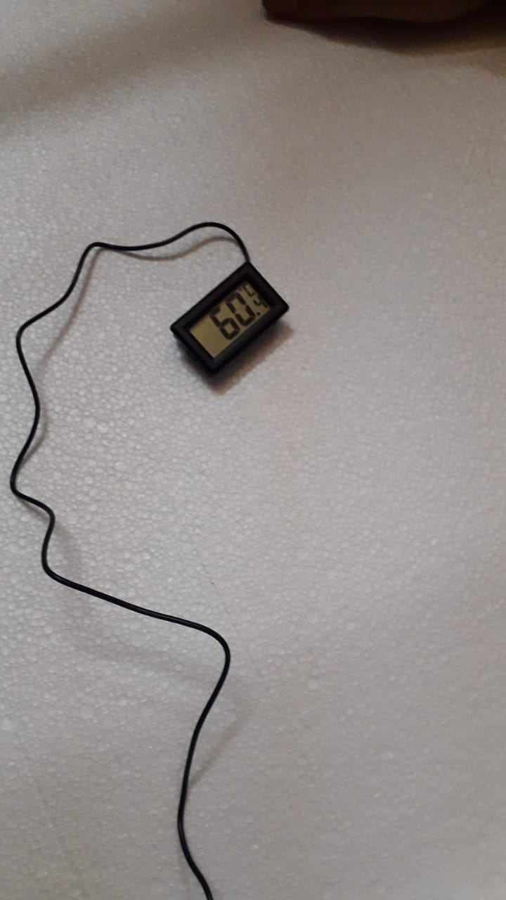
Thermal Test Results
Pictures after and during the test

Slide 15
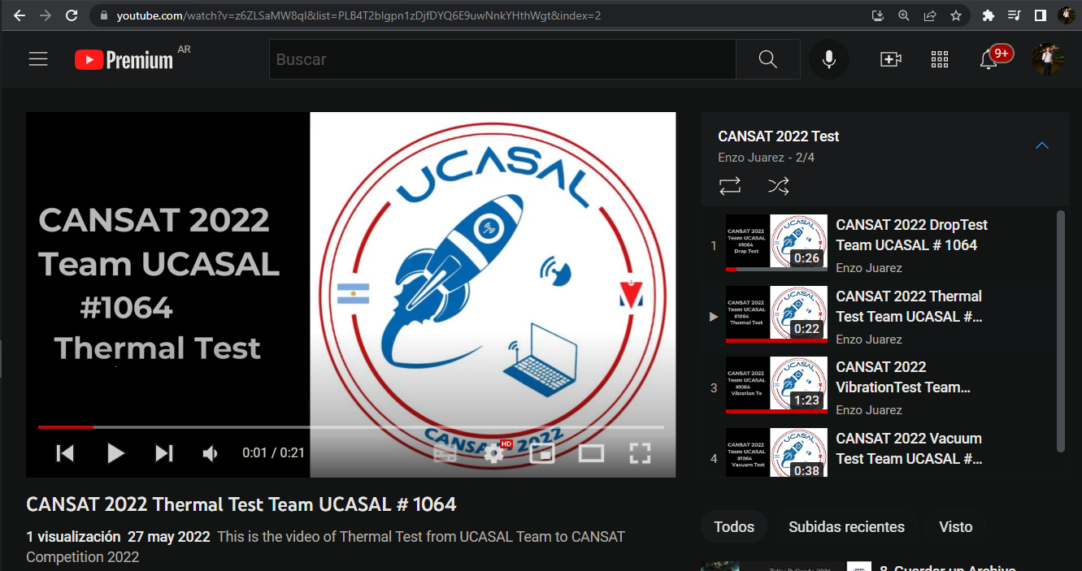
Thermal Test Results
Thermal test video link:
https://www.youtube.com/watch?v=z6ZLSaMW8qI&list=PLB4T2blgpn1zDjfDYQ6E9uwNnkYHthWgt&index=2

Slide 16
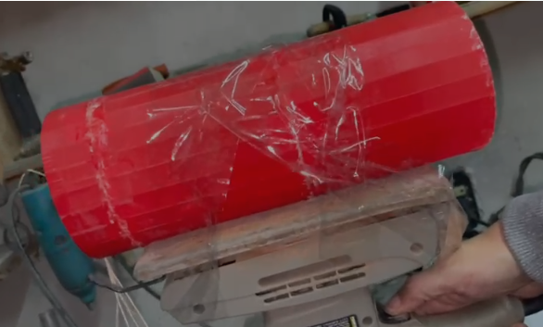
Vibration Test Configuration
We use a sander secured to a vise, then the cansat was secured with duct tape and the vibration test was made power on and off in short cycles and checking that telemetry was correct.
Materials used:
Power sander

Slide 17
Vibration Test Procedures
Vibration Test Procedures
Power on the CanSat.
Verify accelerometer data is being collected.
Power up the sander.
Once the sander is up to full speed, wait 5 seconds.
Power down the sander to a full stop.
Repeat steps iii to v four more times.
Inspect the CanSat for damage and functionality.
Verify accelerometer data is still being collected.
Power down CanSat.

Slide 18
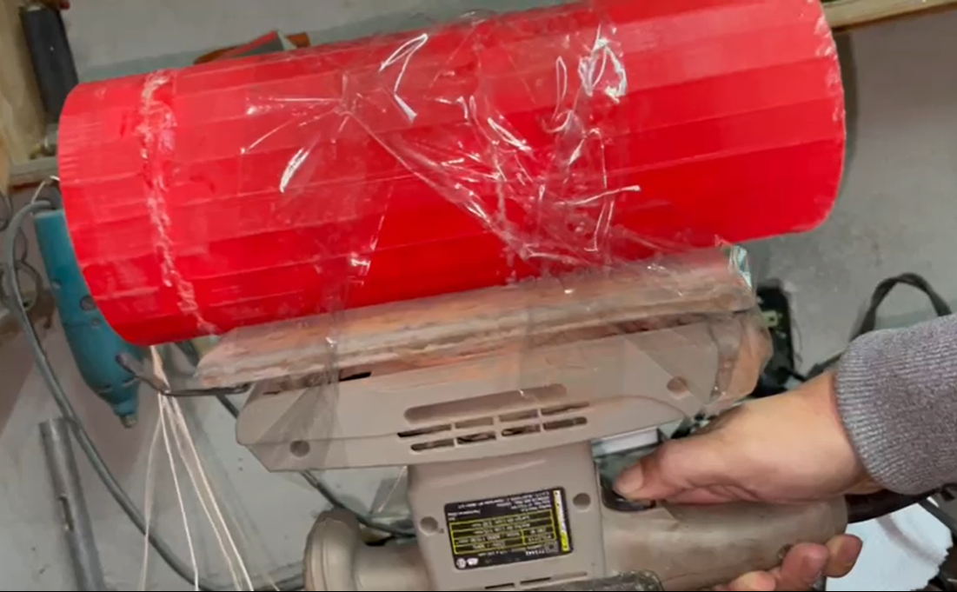
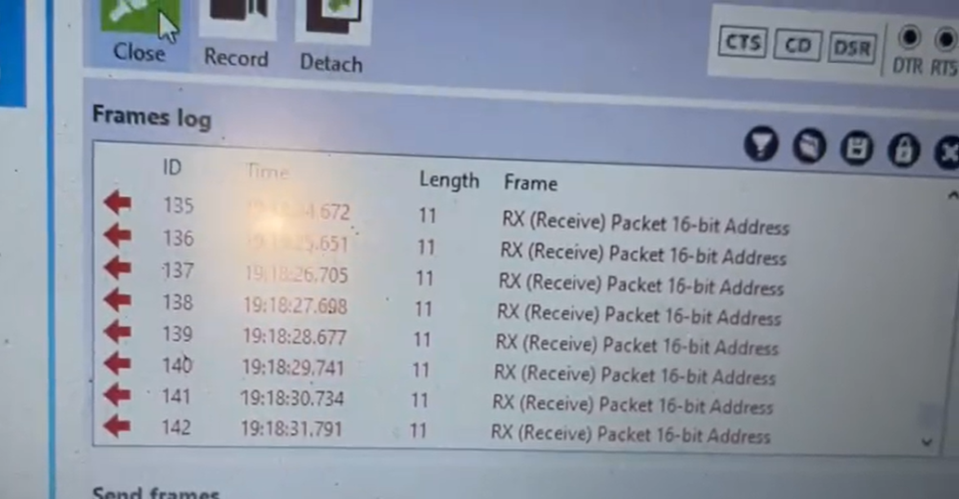
Vibration Test Results

Slide 19
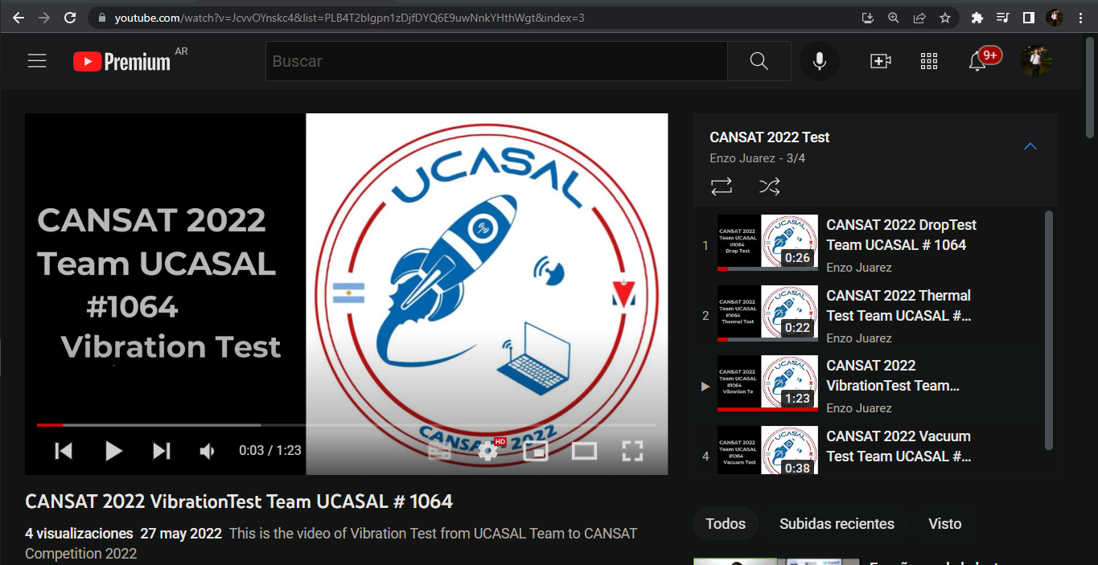
Vibration Test Results
Vibration test video link:
https://www.youtube.com/watch?v=JcvvOYnskc4&list=PLB4T2blgpn1zDjfDYQ6E9uwNnkYHthWgt&index=3

Slide 20
Vacuum Test Configuration
List materials used
A bucket 18 litres
A vacuum cleaner (was broken before the test)
This test could not be performed because the vacuum cleaner broke before it.

Slide 21
Vacuum Test Procedures
This test could not be performed because the vacuum cleaner broke before it.

Slide 22
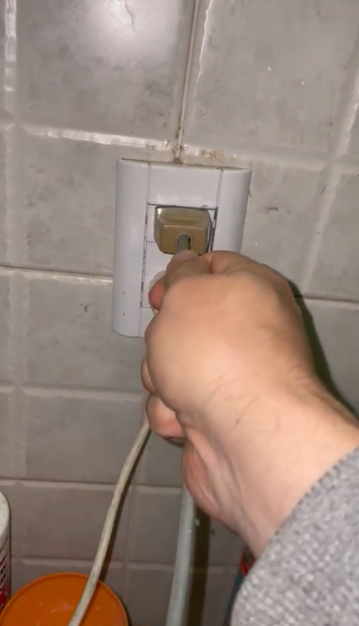
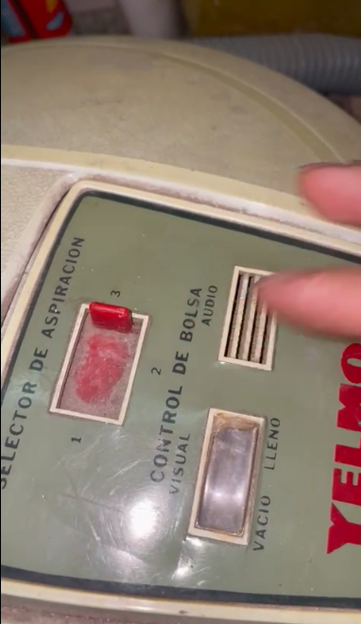
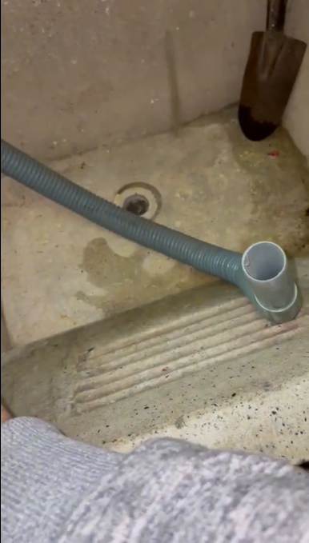
Vacuum Test Results
Show picture of just before vacuum test

Slide 23
Vacuum Test Results
The 1064 agrees to get a new vacuum cleaner, to be able to carry out this test correctly, and send the result.

Slide 24
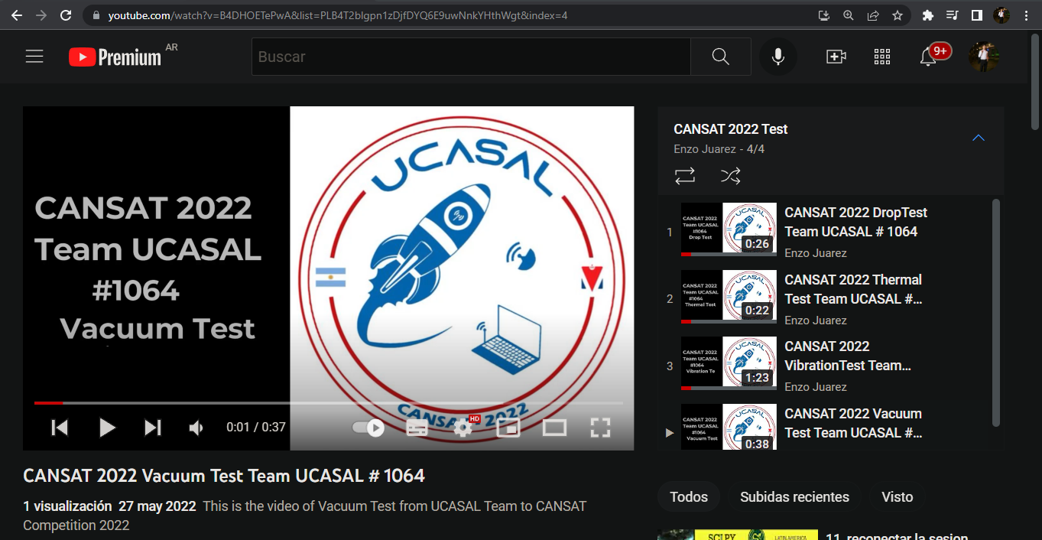
Vacuum Test Results
Vacuum test video link:
https://www.youtube.com/watch?v=B4DHOETePwA&list=PLB4T2blgpn1zDjfDYQ6E9uwNnkYHthWgt&index=4

Slide 25
Summary
Drop test worked correctly.
Thermal test worked correctly.
Vibration test worked correctly.
Vacuum test didn’t work correctly, because the vacuum cleaner was broken before the test.

